Slide 1



Self Details:
Name: Nammi NarasimhaMurthy
Gmail id: narasimhamurthynammi712@gmail.com
Linked in:
https://www.linkedin.com/in/narasimhamurthynammi/?utm_source=share&utm_campaign=share_via&utm_content=profile&utm_medium=android_app
Education Qualification : BTech (2 year)
Software Role:- Python Full Stack Web Developer and Passinate about AI/ML

Slide 2
Contents
Business Objective: minimize unplanned machine downtime
Business Constraints:
Minimize the maintance cost
Maximize equipment Efficiency
Project Architecture - Data Flow Diagram
Data Collection:secondary data collection
Exploratory Data Analysis
Data Visualization
Notes:
Change

Slide 3
Business Problem
Bussiness problem:
Unplanned machine downtime which is lead to loss of product
Business Constraints:
Minimize the maintance cost
Maximize equipment Efficiency
Bussiness object:
Minimize the unplanned machine downtime

Slide 4
Project Overview and Scope
The Machine Downtime Project aims to minimize machine downtimes Key activities include data collection, analysis, preventive maintenance, and continuous monitoring.
Project Overview:Unplanned machine stops are stealing our production! This project tackles the root causes to get machines humming again, boosting output and saving us money. By focusing on prevention and quick fixes, we'll keep the lines running smoothly.
Scope: This project will focus on identifying and addressing the root causes of unplanned downtime within a specific production line or facility.

Slide 5
Data Dictionary
Show drafts
Hydraulic Pressure (measured in bars) is a key metric used to monitor the health and performance of hydraulic machinery.
Coolant Pressure (bar) measures the force of the machine's cooling liquid, which absorbs heat to prevent overheating
Air_System_Pressure (bar) indicates the force of compressed air powering machine functions.
Coolant_Temperature (°C) reflects the coolant's heat absorption effectiveness.
Hydraulic_Oil_Temperature (°C) shows how hot the hydraulic fluid is, impacting system performance.
Spindle_Bearing_Temperature (°C) monitors heat in the bearings, crucial for smooth rotation and machine precision.
Spindle_Vibration (unit unspecified) indicates machine shaft movement, potentially affecting precision and component wear.
Tool_Vibration (unit unspecified) reflects cutting tool movement, impacting product quality and potentially causing damage.
Spindle_Speed (RPM) indicates the rotational speed of the tool holder, affecting cutting efficiency and finish.
Voltage (V) shows the electrical pressure powering the machine, impacting performance and potentially causing malfunctions.
Torque (Nm) reflects the twisting force applied by the machine, crucial for proper operation and affecting cutting power.
Cutting (kN) indicates the force exerted while cutting material, impacting efficiency, product quality, and potential tool wear.

Slide 6
Exploratory Data Analysis [EDA]
Statistical Insights
Business Insights
Cost of Downtime:
Quantify the financial impact of downtime on your business. This could include lost production revenue, additional labor costs for repairs, and potential customer penalties for missed deadlines.
Use visuals like charts or graphs to showcase the cost per minute or hour of downtime.
Focus on High-Impact Areas:
Present specific examples of how addressing these key causes can translate to significant cost savings and production gains.
Acknowledge the findings: Be upfront about the lack of statistically significant results. Don't try to hide or downplay them.
Explain the limitations: Discuss potential reasons why the results might be insignificant, such as:
Insufficient data collection period.
Smaller than ideal sample size.
External factors influencing downtime not
captured the data
Notes:
EDA is used for seeing what the data can tell us before the modeling task.
Change

Slide 7
Data Preprocessing
First focusing on the initial exploration and understanding of the data for given dataset
Calculate the statistics for numerical features like mean, median, standard deviation
Remove the outliers from dataset or remove a missing data from dataset using some of methods
Graphicall representation or data visualization for the dataset using matplotlib and seaborn librarys
Notes:
Keep observations

Slide 8
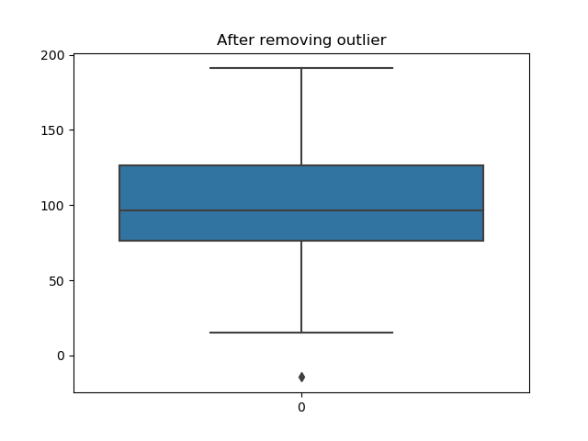
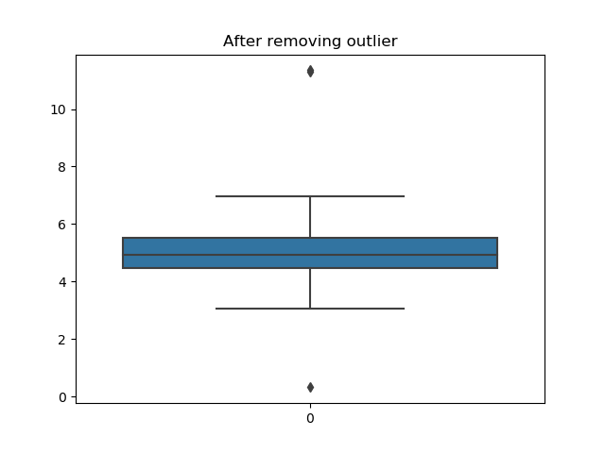
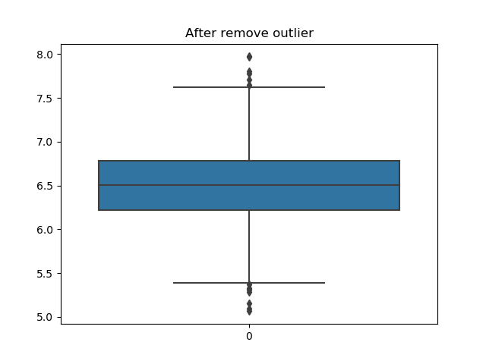
Data Visualization
Hydraulic_Pressure(bar)
Coolant_Pressure(bar)
Air_System_Pressure(bar)
Notes:
Add graphical

Slide 9
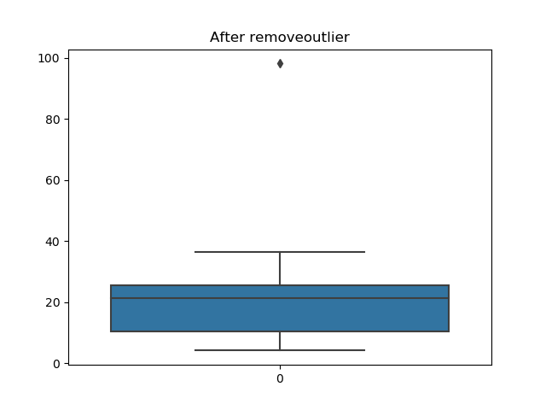

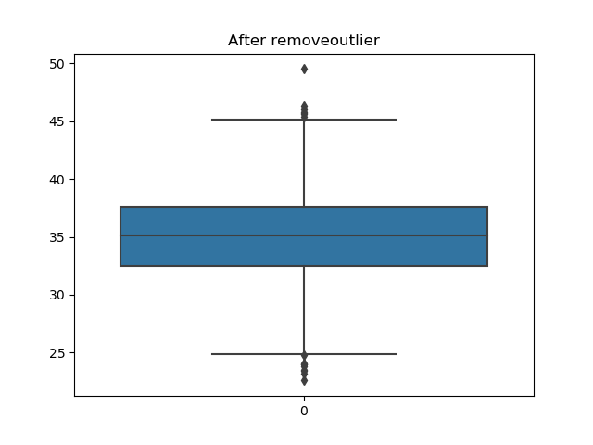
Data Visualization
Coolant_Temperature
Hydraulic_Oil_Temperature
Spindle_Bearing_Temperature

Slide 10
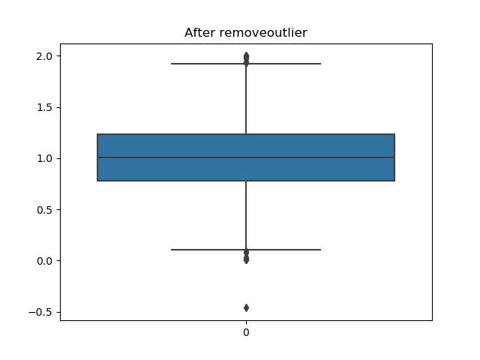
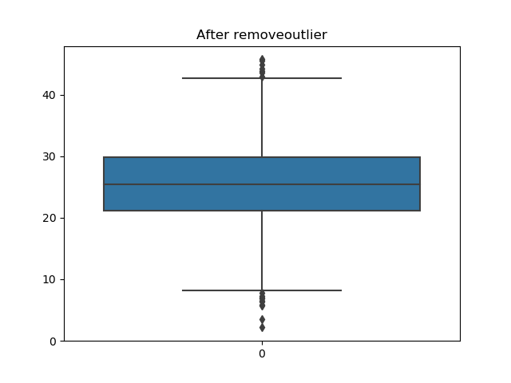
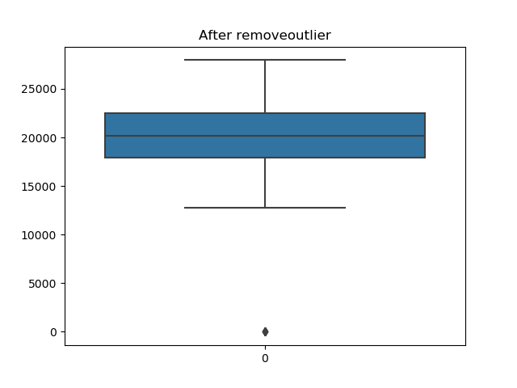
Data Visualization
Spindle_Vibration
Tool_Vibration
Spindle_Speed

Slide 11
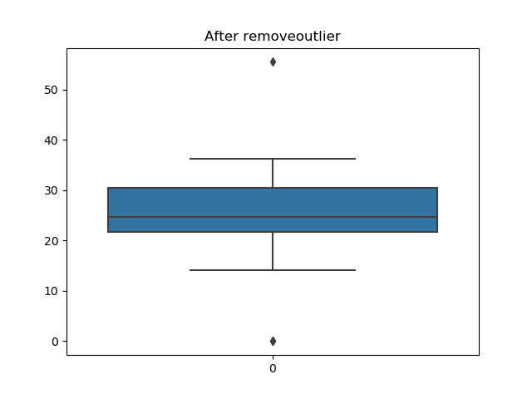
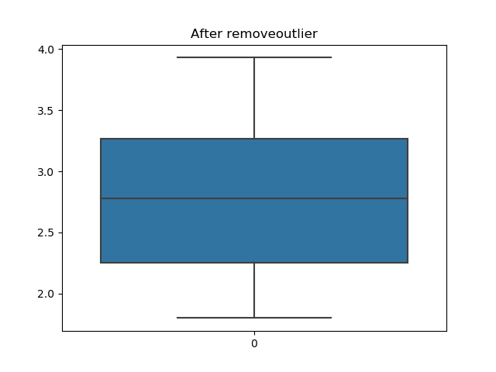
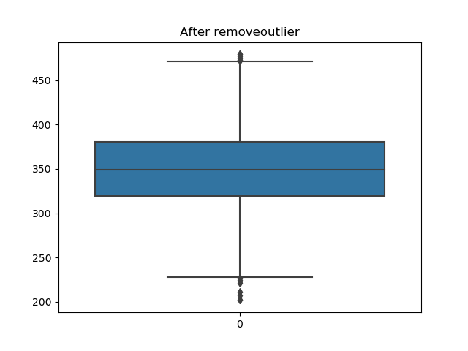
Data Visualization
Torque
Cutting(kN)
Voltage

Slide 12


